Slide 1
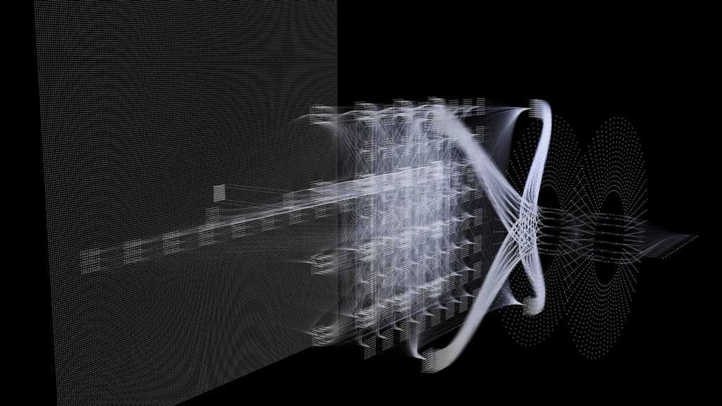
SESSION 05
WORKSHOP MARCH 2026 BY DR CORONA-LOPEZ
TRANSFER LEARNING
FACULTY OF SCIENCE AND ENGINEERING
UNIVERSITY OF MANCHESTER

Slide 2
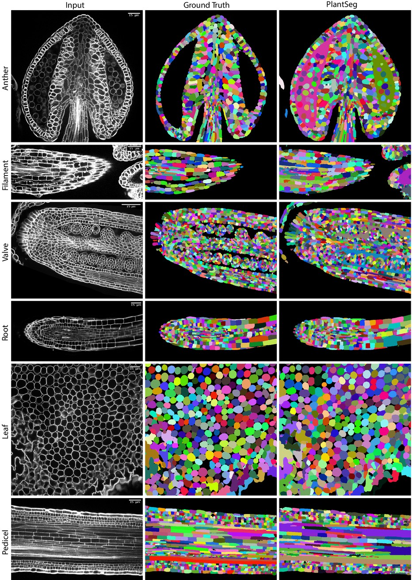
BY DR CORONA-LOPEZ
MARCH 2026
AGENDA
transfer learning: core concepts, and when to use it
dataset preparation: custom PyTorch dataset structure, computing dataset stats for normalization
albumentations: synchronised image & mask augmentation
Baseline architecture & loss: intro to U-Net structure, and tackling imbalance with dice loss
implementing transfer learning: intro to EfficientNet architecture, building Efficient U-Net, handiling feature map mismatches, and freezing pre-trained weights
01

Slide 3
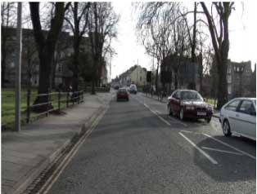
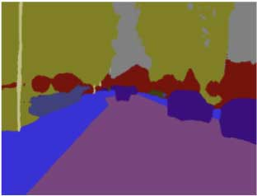
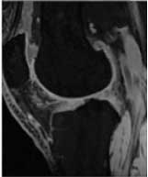
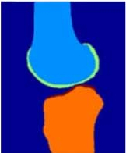
transfer learning is a technique where a model developed for one task is reused as a starting point for a model on a second task. it leverages knowledge from pre-trained models instead of starting from scratch it is particularly effective for deep learning models that require massive datasets and computational resources
SOURCE
PRE-TRAINED
SOURCE
DOMAIN
MODEL
TARGETS
TARGET
TRANSFER
TARGET
DOMAIN
LEARNING
OUTPUT
02

Slide 4
BY DR CORONA-LOPEZ
MARCH 2026
USE CASES
the effectiveness depends on similarity between source and target domains
SCENARIO | EXAMPLE | BENEFIT
LIMITED TRAINING DATA | medical imaging with few samples | pre-trained features compensate for data scarcity
SIMILAR DOMAINS | from natural images to satellite imagery | underlying features (edges, textures) transfer well
TIME CONSTRAINTS | rapid prototyping needs | accelerates model development cycle
HARDWARE LIMITATIONS | training with limited gpu access | reduces computational requirements
PREVENTING OVERFITTING | small dataset applications | regularization effect from pre-trained weights
03

Slide 5
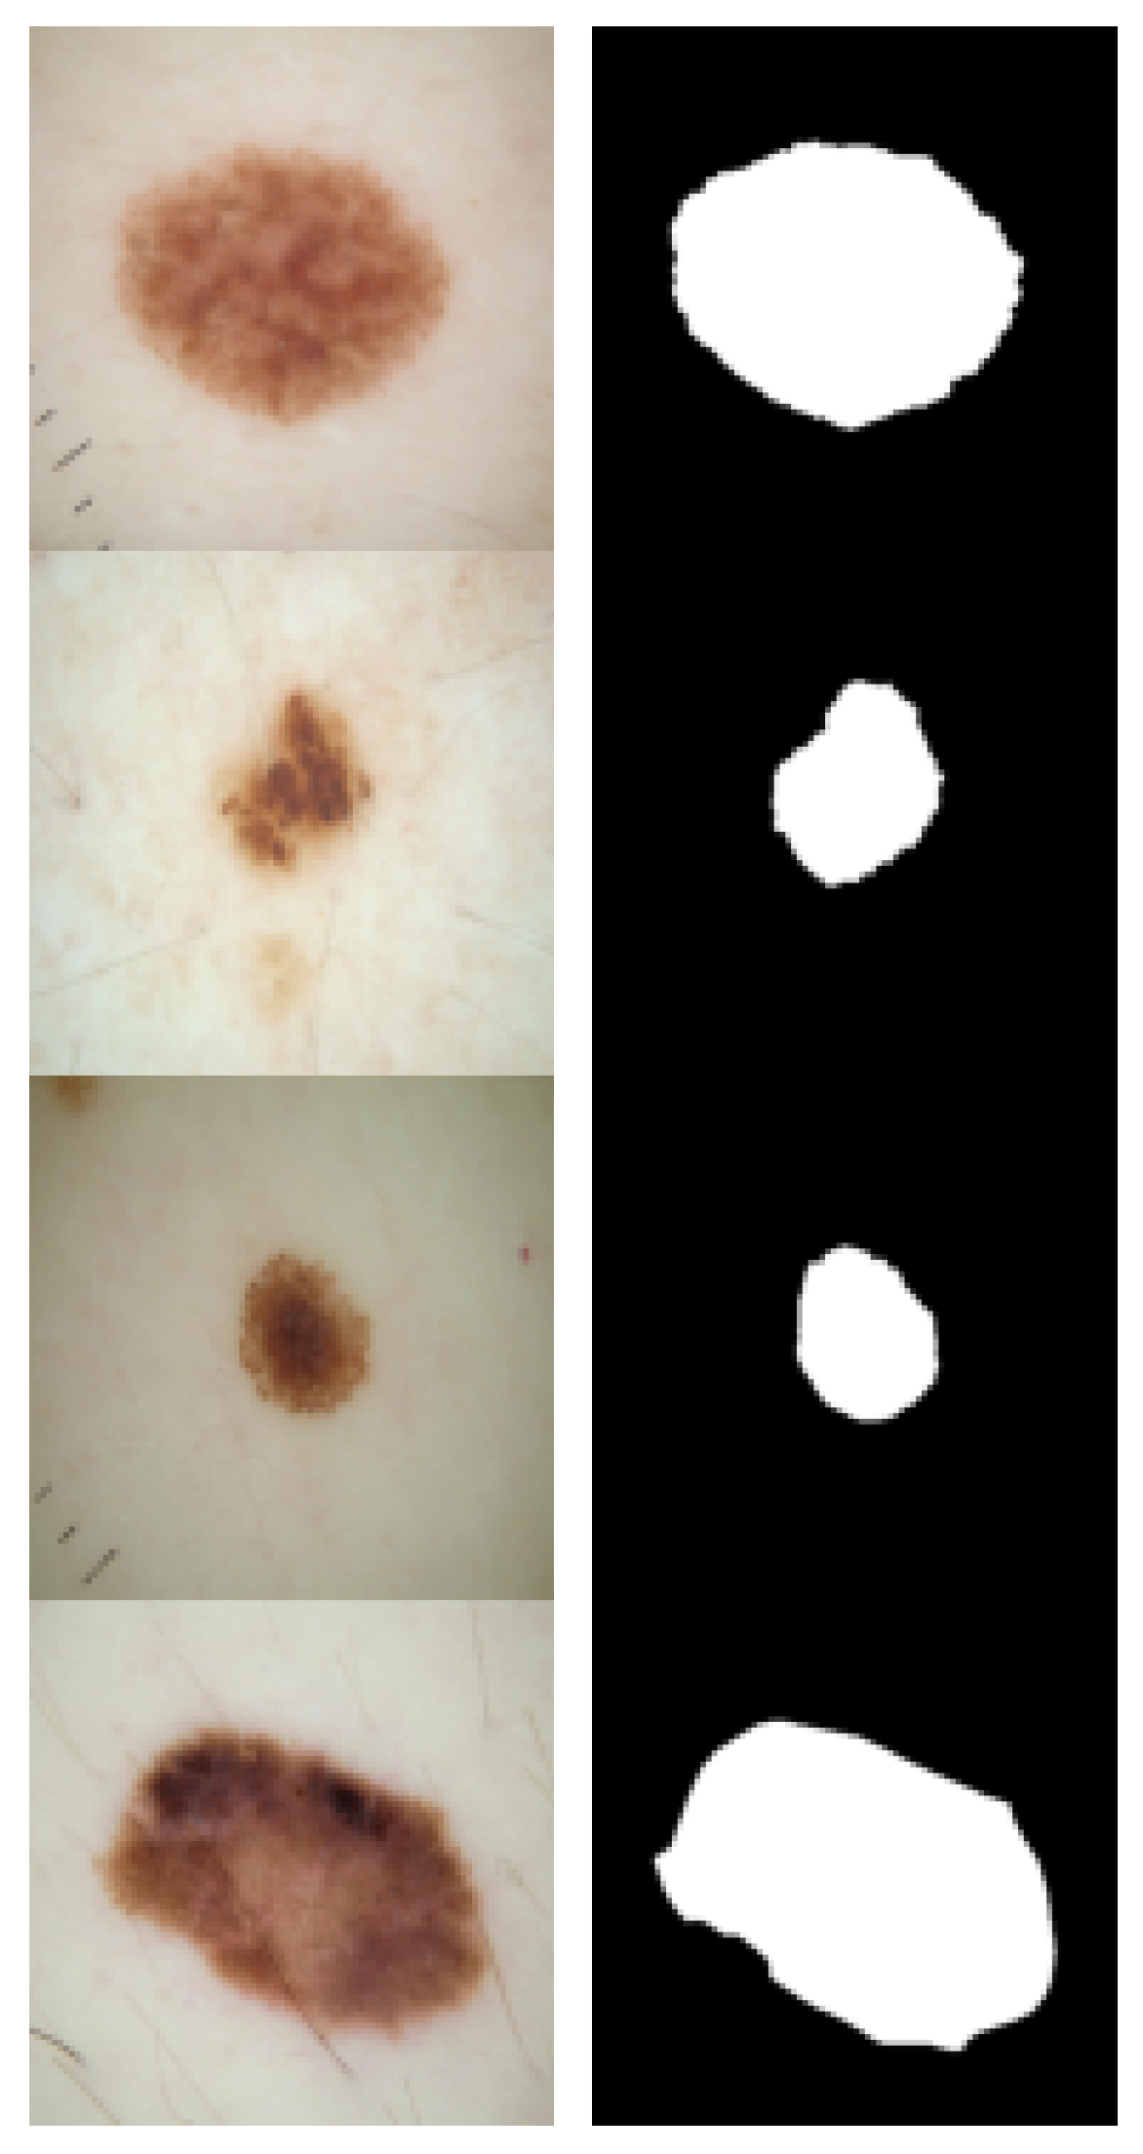
BY DR CORONA-LOPEZ
MARCH 2026
ISIC 2016
image
MASK
medical datasets like ISIC are typically smaller than general computer vision datasets, making transfer learning particularly valuable
contains dermoscopic images of skin lesions with expert-annotated segmentation masks
900 training images and 379 test images with corresponding binary masks
critical for developing automated diagnostic tools for early melanoma detection
challenging due to varying lesion sizes, shapes, colours, and skin types
04

Slide 6
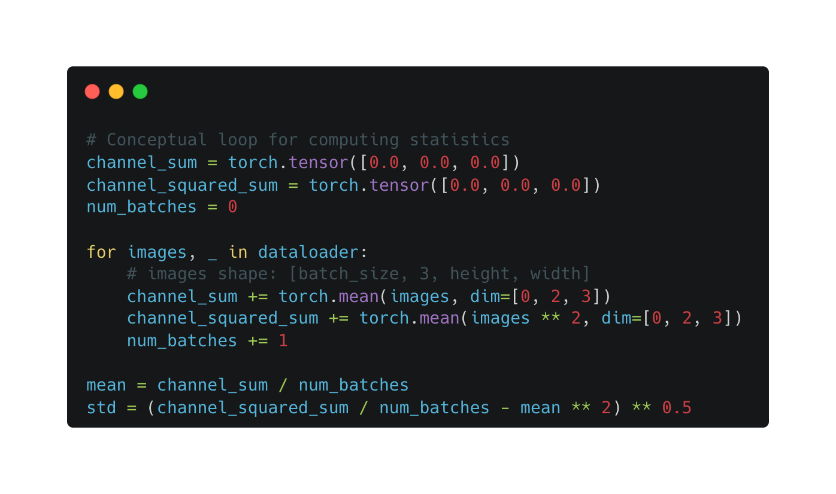
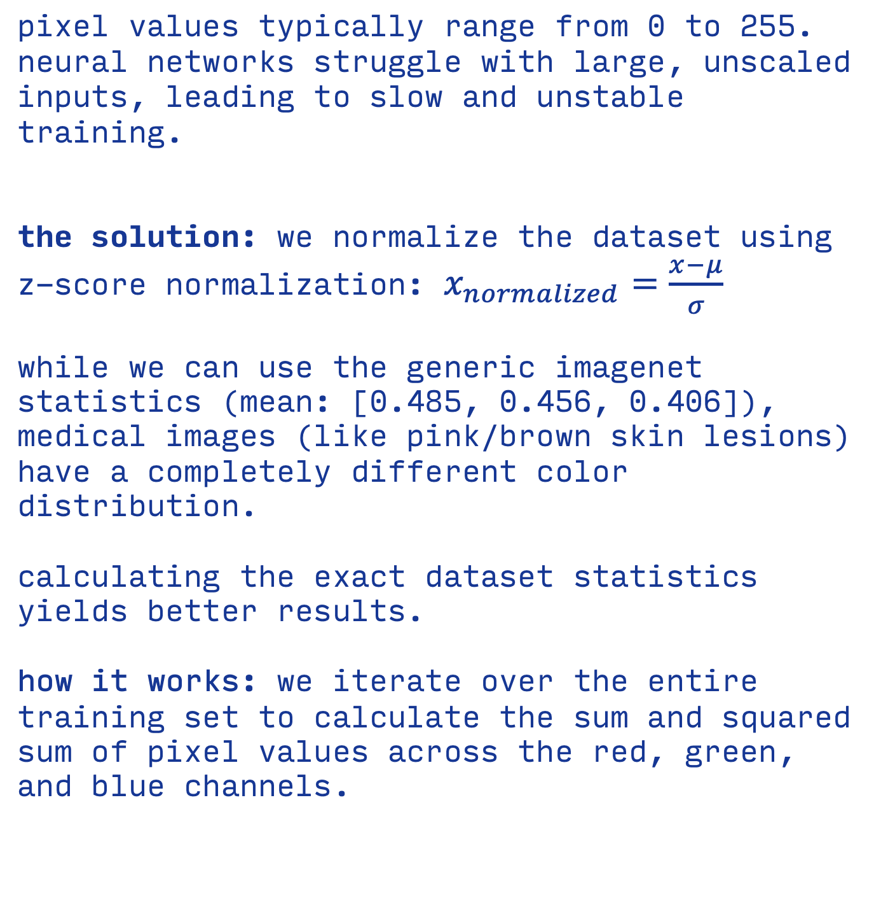
BY DR CORONA-LOPEZ
MARCH 2026
DATA NORMALIZATION
pixel values typically range from 0 to 255. neural networks struggle with large, unscaled inputs, leading to slow and unstable training.
the solution: we normalize the dataset using z-score normalization: $x_{normalized}=\frac{x−μ}{σ}$
while we can use the generic imagenet statistics (mean: [0.485, 0.456, 0.406]), medical images (like pink/brown skin lesions) have a completely different color distribution.
calculating the exact dataset statistics yields better results.
how it works: we iterate over the entire training set to calculate the sum and squared sum of pixel values across the red, green, and blue channels.
05

Slide 7
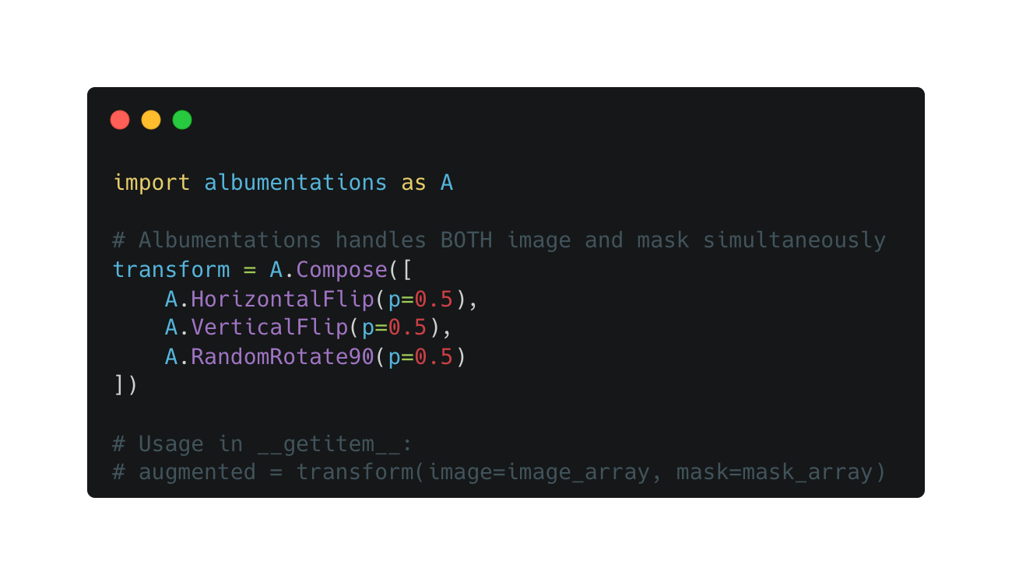
BY DR CORONA-LOPEZ
MARCH 2026
DATA AUGMENTATION & SYNC
in standard image classification, if you rotate a picture of a cat 90 degrees, the label remains "cat".
the segmentation way (sync): in segmentation, the "label" is a pixel-perfect mask. if you flip the image, you must flip the mask in the exact same way. if they fall out of sync, the network learns garbage.
the solution: standard torchvision struggles with synced mask augmentation.
this is why we switch to the albumentations library, which handles synchronized (image, mask) transforms natively.
06

Slide 8
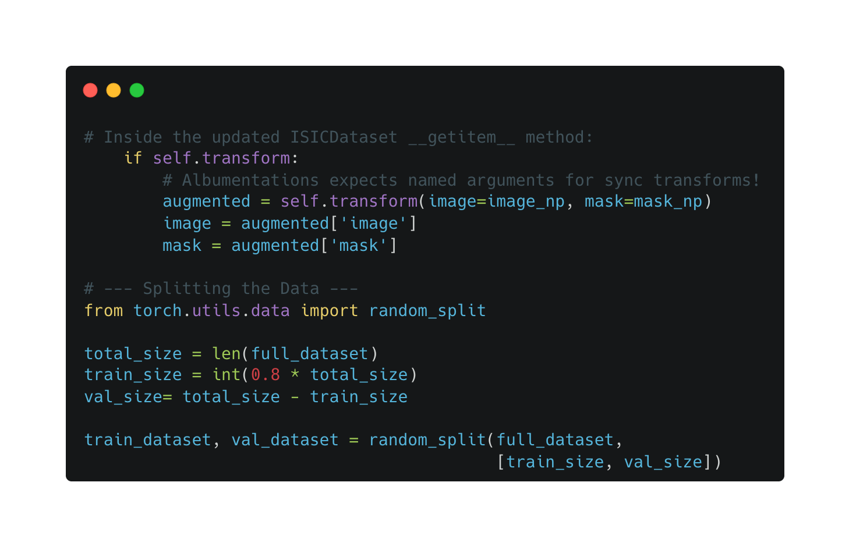
BY DR CORONA-LOPEZ
MARCH 2026
DATA AUGMENTATION & SPLITTING
the wrapper: because albumentations requires numpy arrays and returns a dictionary, we need to update our dataset's __getitem__ method to properly pass both the image and mask to the transform function.
train/validation split: we never train on all our data. we must reserve a portion (usually 20%) to validate that our model is actually learning generalizable features, not just memorizing the training images.
pytorch random_split: a built-in utility that randomly divides the dataset into non-overlapping subsets.
07

Slide 9
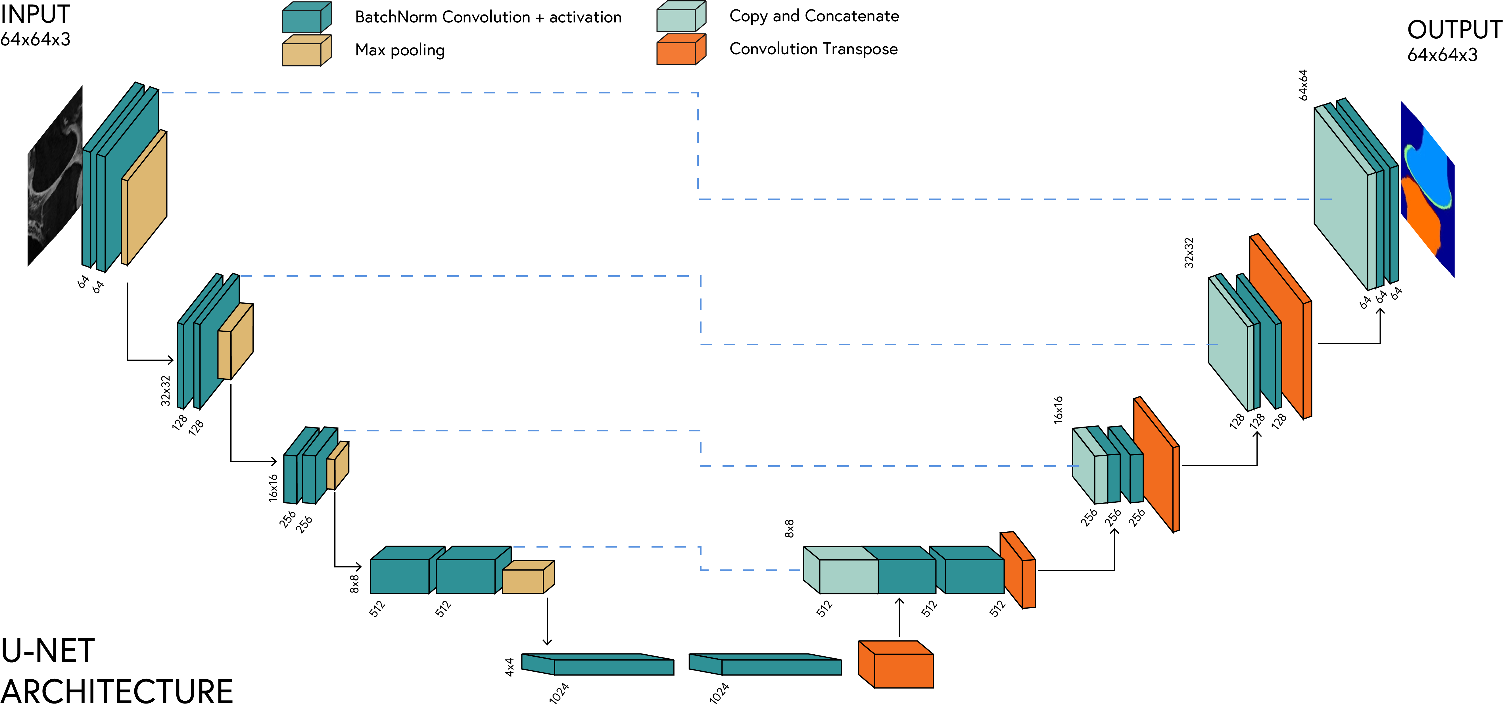
BY DR CORONA-LOPEZ
MARCH 2026
U-NET
encoder-decoder architecture with skip connections
captures both context and localisation information
widely used for biomedical image segmentation
08

Slide 10
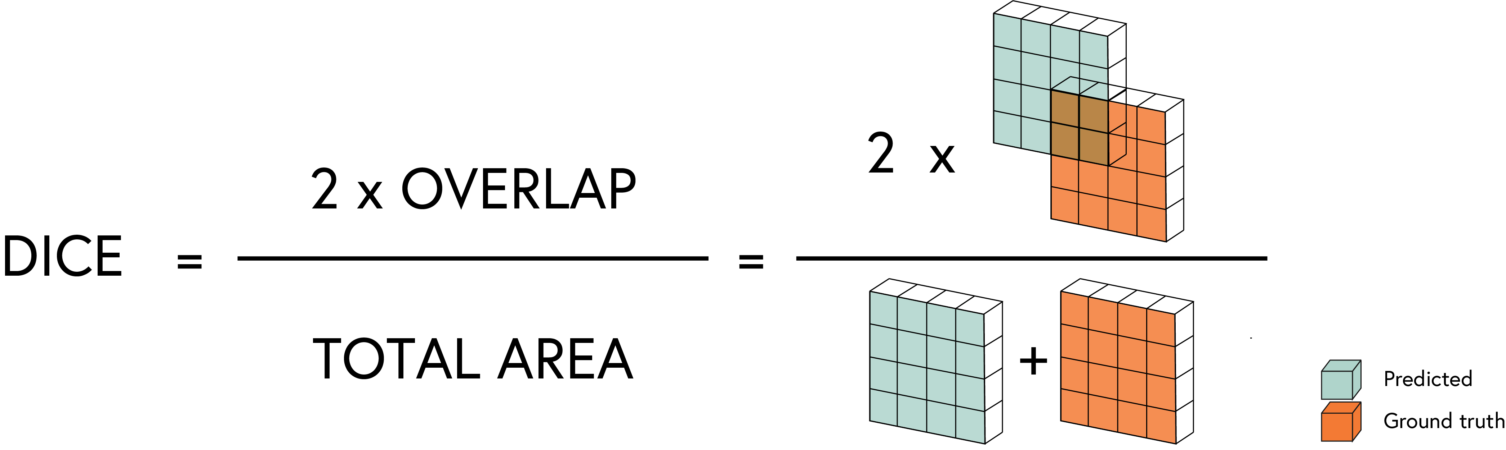
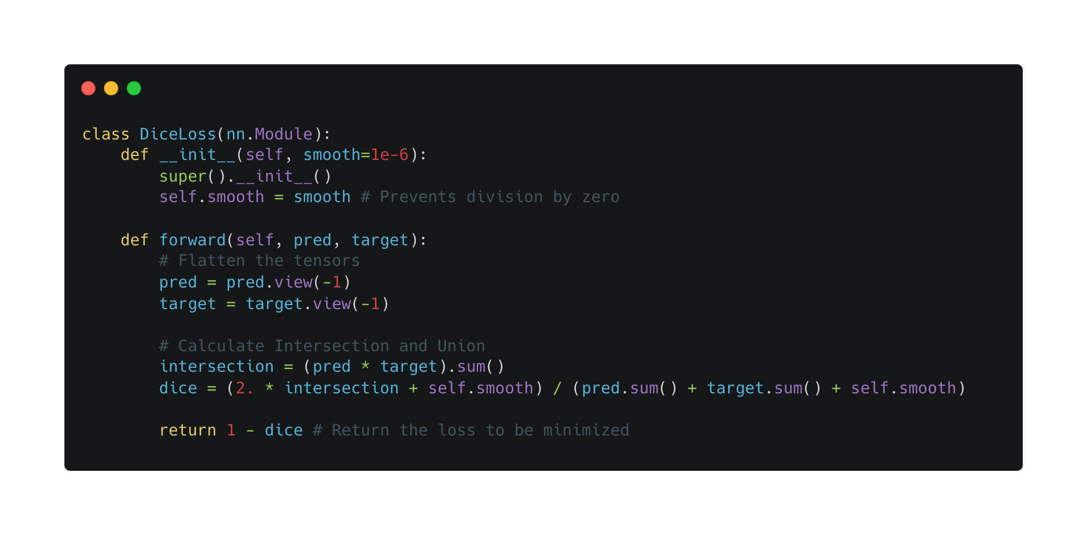

BY DR CORONA-LOPEZ
MARCH 2026
DICE LOSS
the class imbalance problem: in medical imaging, the region of interest (e.g., a skin lesion) often occupies only 5% of the image, while healthy skin/background is 95%.
dice loss:
measures overlap between predicted and ground truth masks
handles class imbalance better than binary cross-entropy
$$\text{Dice}\text{Loss}=1−\frac{2\left|X∩Y\right|}{\left|X\right|+\left|Y\right|}$$
09

Slide 11
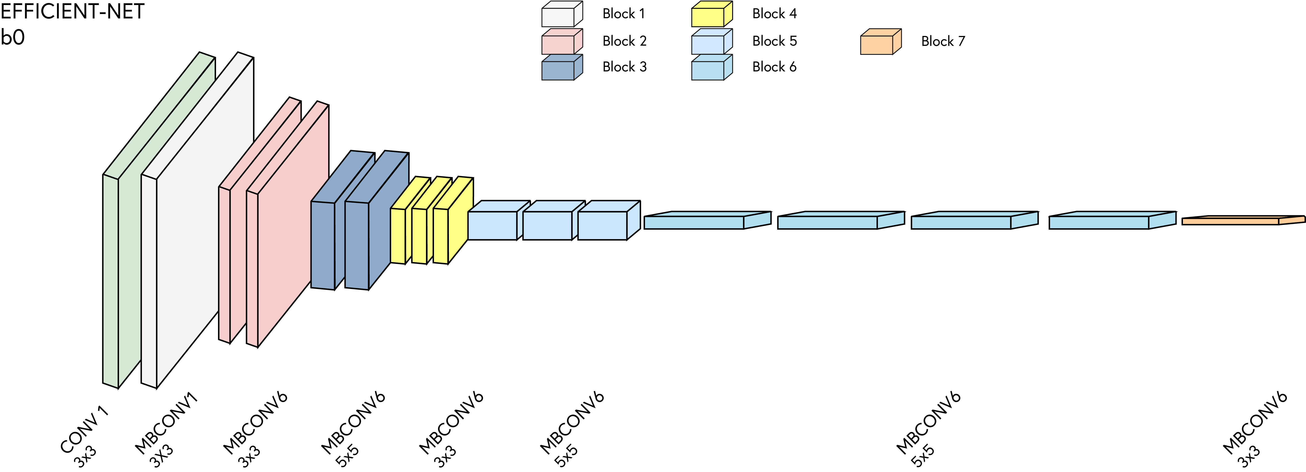
BY DR CORONA-LOPEZ
MARCH 2026
EFFICIENT-NET
introduced by google. achieves state-of-the-art accuracy while being significantly smaller and faster than previous models like ResNet or VGG.
trained on millions of images (image-net), it already knows how to detect edges, textures, and complex shapes perfectly.
10

Slide 12
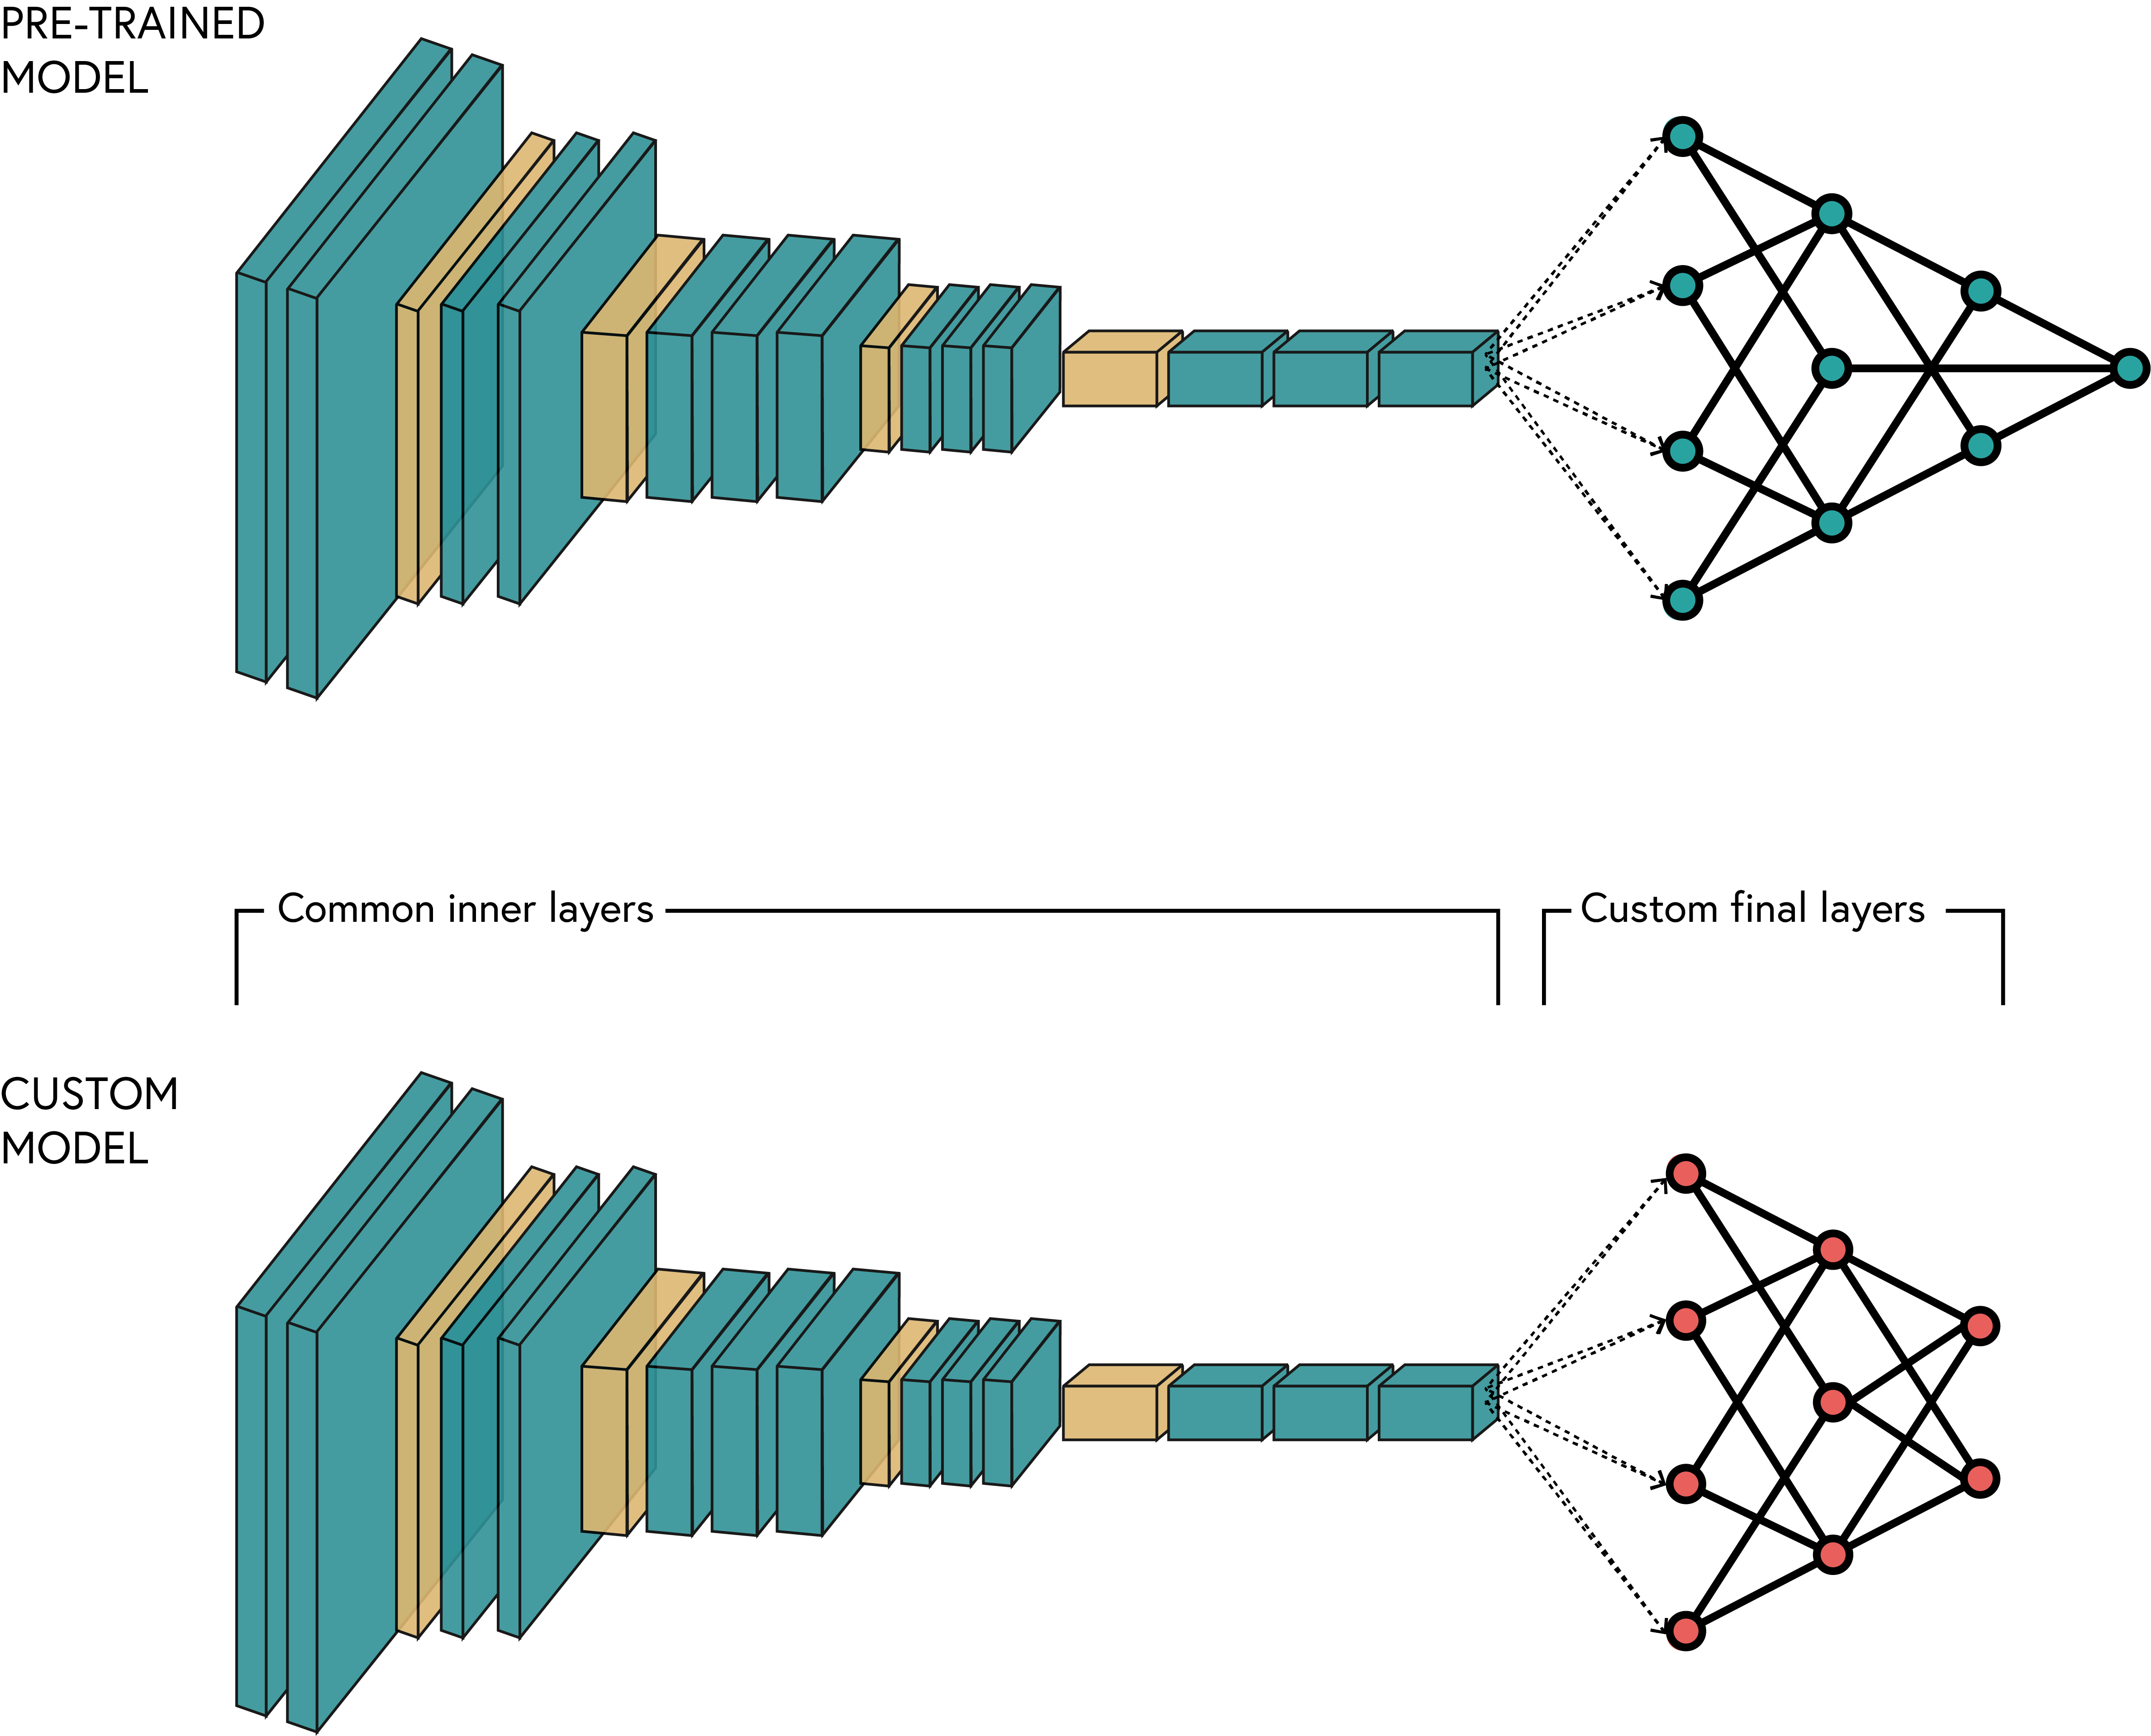
BY DR CORONA-LOPEZ
MARCH 2026
TRANSFER LEARNING
Step 1: Select a Pre-Trained Model
Choose a model architecture that has already been trained on a massive, diverse dataset
Step 2: Modify the Architecture
Strip away the original "head" of the model.
Step 3: Freeze the Base Layers
Lock the weights of the pre-trained layers (requires_grad = False).
Step 4: Add and Train New Layers
Attach your new, untrained layers tailored to your specific task (our U-Net Decoder).
Step 5: Fine-Tuning (Optional but powerful)
Once the new layers are stable, "unfreeze" the entire model. Train for a few more epochs using a very small learning rate.
11

Slide 13
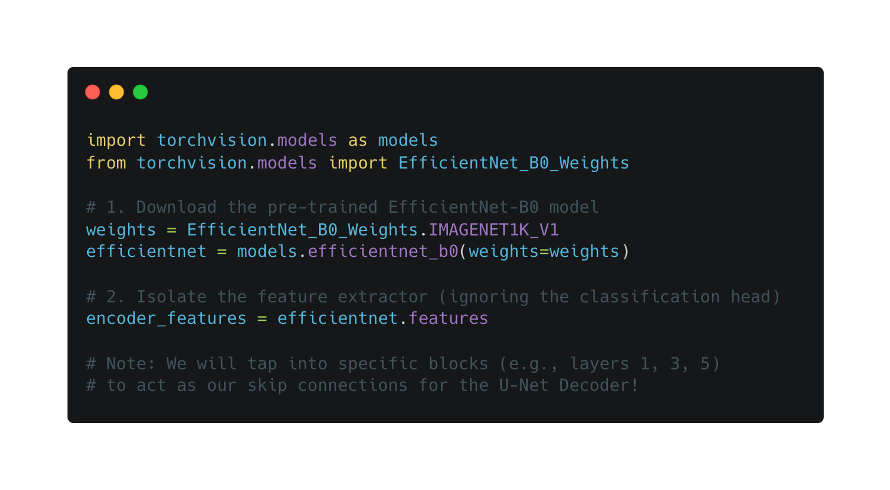
BY DR CORONA-LOPEZ
PRE-TRAINED WEIGHTS
the torchvision.models API: pytorch makes it incredibly simple to download pre-trained models.
the weights object: we specify IMAGENET1K_V1 to ensure we get the model that has already learned from the massive imagenet dataset.
feature extraction (features): we don't want the whole classification model. we specifically target the .features module of efficientnet to extract the intermediate feature maps needed for our u-net skip connections.
12

Slide 14
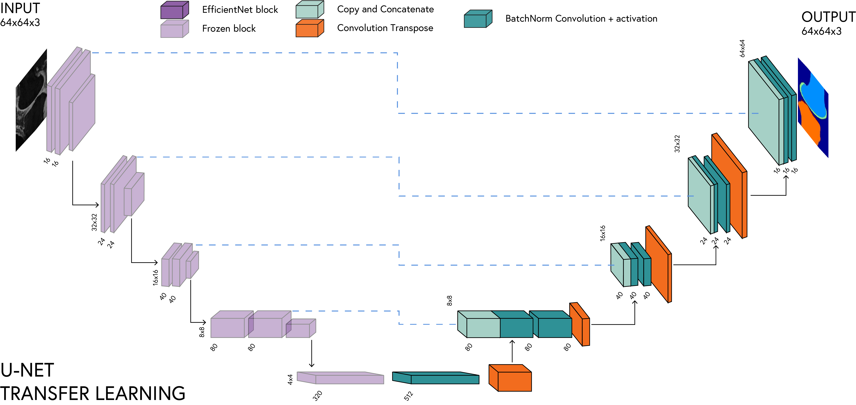
BY DR CORONA-LOPEZ
FEBRUARY 2026
EFFICIENT
U-NET
the hybrid architecture: we are fusing two ideas: the powerful feature extraction of efficientnet (encoder) + the precise spatial localization of u-net (decoder).
13

Slide 15
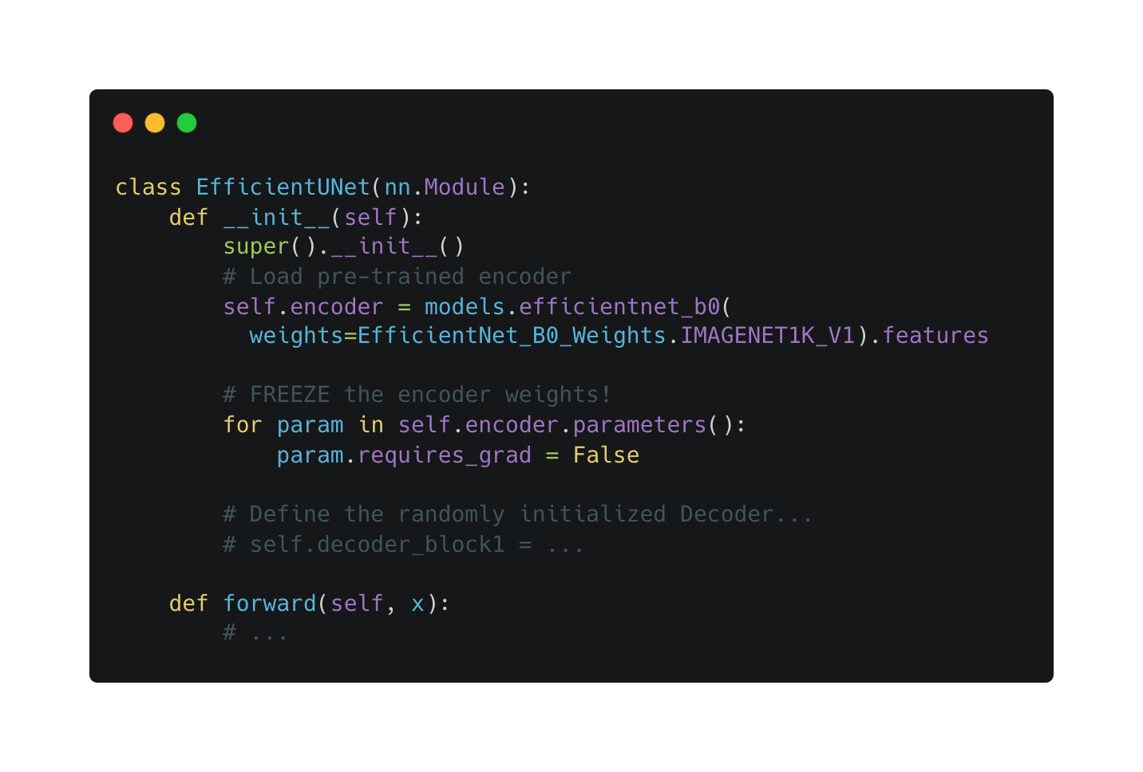
BY DR CORONA-LOPEZ
FEBRUARY 2026
FREEZING
the danger of random initialization: our new u-net decoder has completely random weights. if we start training immediately, the massive errors from the random decoder will backpropagate into our pre-trained encoder.
the solution -> "freezing": we must turn off gradient tracking (requires_grad = false) for the efficientnet encoder during the initial training phase.
the workflow: train only the decoder for a few epochs until it learns how to use the encoder's features. then, optionally "unfreeze" the encoder and train everything together with a tiny learning rate (fine-tuning).
14

Slide 16
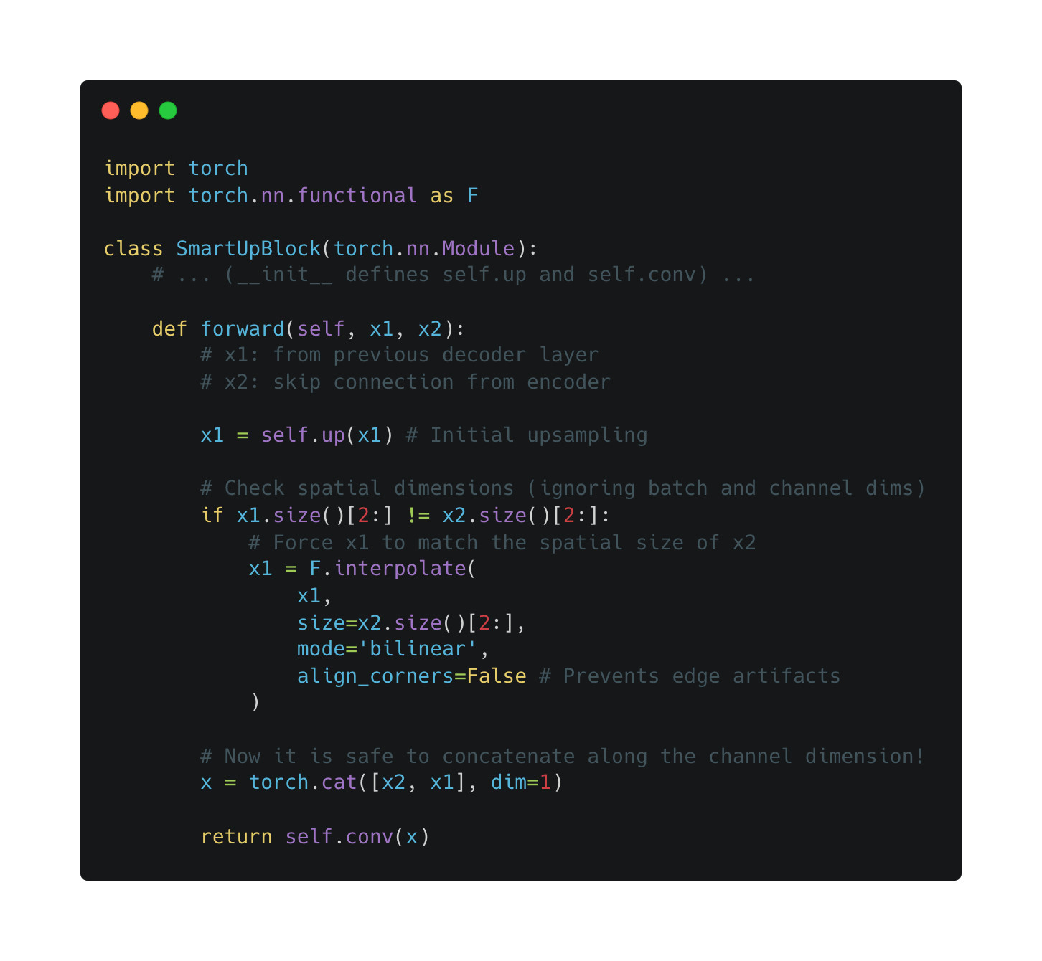
BY DR CORONA-LOPEZ
FEBRUARY 2026
SMART-UP
standard u-nets are perfectly symmetrical.
however, when you swap in an external pre-trained encoder like efficientnet, the spatial dimensions (height/width) of the skip connections might not perfectly match your decoder's upsampled feature maps due to different padding or strides in the efficientnet blocks.
the error: if you try to concatenate two tensors with different spatial sizes (e.g., a 56x56 map with a 55x55 map), pytorch will throw a runtime shape error.
the solution: after the standard transposed convolution, we check if the sizes match. if they don't, we dynamically resize the upsampled tensor to perfectly match the skip connection using bilinear interpolation.
15

